Slide 1
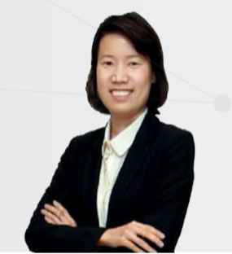
Ms. Jureerat Lapanavanich
IC Candidates
Education
• Master of General Management, Mahidol University
• Bachelor of Internation Management, Chulalongkorn University
Working Experiences
• 2015 – Present: Executive Vice President of Accounting and Financial of Millcon Steel Plc.
• 2015 – Present: Investment Committee Member of Millcon Steel
• 2014 – 2015: Director of Millcon Special Steel Co.,Ltd.
• 2012 – 2015: Director of Zentra-wartung Engineering Co., Ltd.
• 2011 – 2014: Head of CEO Office of Millcon Steel Plc
• 2010 – present: Director of Millcon Burapa Co.,Ltd.
• 2009 – present: Executive Director of Millcon Steel Plc.

Slide 2
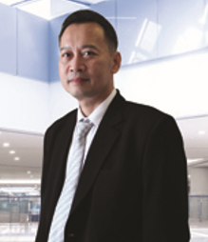
Mr. Ratchai Pichayapoom
IC candidates
Education
• Master of Business Administration (MBA) Financial Management, Utah State University, Utah, USA
• Bachelor of Business Administration majoring in management, Kasetsart University
Working Experiences
• 2016 - Present: Director, Executive Director, Authorized Director of EMC Public Company Limited
• 2016 - Present: Director of Sajja Bangsaen Condominium Co., Ltd.
• 2016 - Present: Director of Richman Property Company Limited
• 2016 - Present: Director of North Property Company Limited
• 2016 - Present: Director of Imperial Land Company Limited
• 2016 - Present: Director of Siam Bangkok Development Co., Ltd.
• 2010 - 2016: Director of PAE (Thailand) Public Company Limited

Slide 3
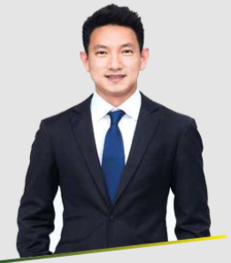
Dr. Tawat Anantanavanich
IC Candidates
Education
• Ph.D. in Civil Engineering, University of California, Berkeley, CA
• M.Eng in Civil Engineering, University of California, Berkeley, CA
• B.Eng in Civil Engineering, Chulalongkorn University
Working Experiences
• 2017 – Present: Director of General Nippon Concrete Industries Co., Ltd.
• 2015 – Present: Director of Seven Wire Co., Ltd.
• 2015 – Present: Director of General Engineering Mauritius Limited
• 2013 – Present: Director and Managing Director/ Member of Risk Oversight Committee of General Engineering Public Company Limited
• 2013 – Present: Director of McTric Public Company Limited
• 2014 – 2015: Director of Millcon Engineering Limited
• 2014 – 2015: Director of Wisdom Tree Investment (S) PTE.Limited
• 2013 – 2015: Director of Suntech Metal Co.Ltd.
• 2013 – 2015: Director of World Wire Processing Co. Ltd.
• 2009 – 2013: Project Director of U and O Corporation, Ltd., Bangkok, Thailand
• 2007 – 2009: Senior Engineer of AMEC Geomatrix Consultants, Inc.

Slide 4
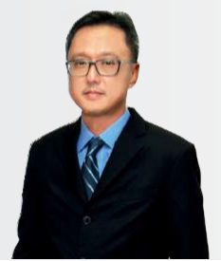
Mr. Vipoota Trakulhoon
IC Candidates
Education
• Master of Business Administration Degree, Sasin Graduate Institute of Business Administration, Chulalongkorn University
• Bachelor of Business Administration degree, Chulalongkorn University
Working Experiences
• 2014: Director of Millcon Steel Plc.
• 2013: Chairman of the Board of Directors of KTB Leasing Co., Ltd.
• 2011: Senior Executive Vice President, Managing Director Corporate Banking Group of Krung Thai Bank Public Co., Ltd.

Slide 5
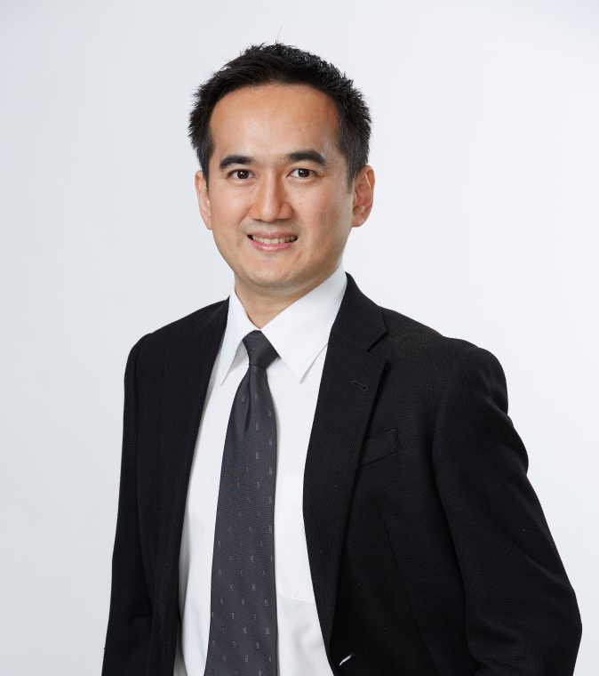
Mr. Chatchai Khunpitiluck
IC Candidates
Education
• Ph.D. Candidate (on leave of absence) in Electrical Engineering, Stanford University, Stanford, CA
• M.Sci in Electrical Engineering, Stanford University, Stanford, CA
• B.Sci in Electrical and Computer Engineering(Honors), Carnegie Mellon University, Pittsburgh, PA
• B.Sci in Computer Science (Honors), Carnegie Mellon University, Pittsburgh, PA
Working Experiences
• 2017 – Present: Senior Executive Vice President & COO – Digital Economy Promotion Agency
• 2012-2017: Vice President & CIO – Software Industry Promotion Agency (Public Organization)
• 2012: Director – Electronic Service Development and Promotion Division, Ministry of Information and Communication Technology
• 2008-2010: Lead Software Developer – Quetouch.com
• 2006-2007: Advisor to the Committee of the Nation Legislative Assembly
• 2003-2012: Trade Negotiator / Internet Architect / Computer Specialist – Ministry of ICT
• 2003-2006: Ministry Spokesperson – Ministry of ICT
• 2005-Present: Instructor – Rajabhat Institute Udonthani, Thailand
• 2002-2003: Managing Director – Catcha Dot Com Co.,Ltd. (an MWEB company)
• 2002: Chief Technology Officer – Catcha Dot Com Ltd. (Singapore, Malaysia, Thailand)
• 2000-2002: Founder / Managing Director – Catcha Dot Com Co.,Ltd.
• 1998-2000: Founder – Siampage.com
• 1998-1999: Member of Technical Staff (Summer) – Silicon Graphic, Inc., California
• 1997: Honors Research Proj. – Dept. of Electrical and Computer Engineering (CMU)
• 1995-1996: Aircraft Maintenance Application, Wireless E-mail, CMU Campus Tour – Engineering Design Research Center (CMU)
• 1994: Programming Research, Dept. of Decision and Social Science

Slide 6
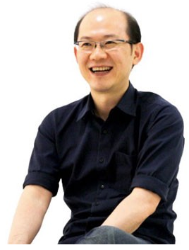
Mr. Shakrit Chanrungsakul
IC Candidates
Education
• Bachelor of Engineering, Electrical and Electronics Engineering, University of the Thai Camber of Commerce
Working Experiences
• 2018 – Present: Partner of Black Pearl Capital Co.,Ltd.
• 2017 – Present: Founder & CEO of Wecosystem Co.,Ltd.
• 2014 – Present: Founder of Peakable
• 2012 – Present: Partner of M8VC Co.,Ltd.
• 2009 – Present: Founder & CEO of FireOneOne Co.,Ltd.
• 2017: CEO of SiriVenture Co.,Ltd.
• 1995 – 2002: Executive Director of 36 Carat Collection

Slide 7
Mr. Shakrit Chanrungsakul
IC Candidates
Industrial & Professional Contribution
Board Member :
NEA — New Economy Academy , The Ministry of Commerce กรรมการบริหารสถาบันพัฒนาผู้ประกอบการการค้ายุคใหม่ กระทรวงพาณิชย์
NSC — National Startup Committee , Education Development Committee รองประธานคณะทำงานเพื่อส่งเสริมการบ่มเพาะวิสาหกิจเริ่มต้น
NIA Ventures (National Startup Committee) คณะทำงานคัดเลือกและกลั่นกรองโครงการ NIA Venture
Bangkok Venture : Screening Committee คณะกรรมการคัดกรองบริษัทสตาร์ทอัพสำหรับกลุ่มนักลงทุน Bangkok Venture

Slide 8
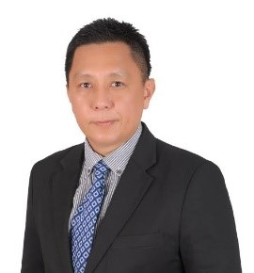
Mr. Pairoj Waiwanijchakij
IC Candidates
Education
• Key Account Management Executive, London Business School
• M.MBA in Business administration, Chulalongkorn University
• M.Eng in Electronics and Telecom, Kasetsar University
• B.Eng in Electronics and Telecom(2th class Honour), Kasetsar University
Working Experiences
• 2018 – Present: Vice Chairman - VVR Asia Co., Ltd.
• 2016-2018: Country Manager – Sterite Technology Ltd.
• 2016: General Manager- Synergy Technology Co., Ltd. And SynHUB Co-Working Space
• 2014-2015: Vice President Digital Product Marketing Management – Advance Info Service Public Company Limited
• 2010-2013: Vice President – Ericsson (Thailand) Limited
• 2006-2010: Senior Business Management Manager – Ericsson (Thailand) Limited
• 2000-2006: Assistant Vice President Sales – Siemens Limited Thailand
• 1998-2000: Project Manager – InterWAVE Communication Lnc., Redwood City, CA, USA
• 1996-1998: Senior Engineer – Wireless Communication Service Co., Ltd.
• 1994-1996: Senior Engineer – Advance Info Service Public Company Limited
•1993-1994: Head Media and Electrical Engineer – Micropolis Corporation Thailand

Slide 9
Mr. Pairoj Waiwanijchakij
IC Candidates
Industrial & Professional Contribution
Dec 2017 – Present : Invited Committee of Thailand Digital and Information Technology’s Standard and Professional Development Engineering Institute of Thailand under the H.M. Patronage
Jul 2017 – Present: Executive Director and Sales and Marketing Consultant, King Telecom Public Company Limited
Jun 2017 – Present: Invited Committee of Information Technology Certification, Thailand Council of Engineers
Sep 2016 – Mar 2017: Invited Member of Senior Consultant – Thailand Telecom Roadmap Development under TIME Consultant Co., Ltd. Ministry of Digital and Economy, Thailand
Mar 2012 – Mar 2014: Member of the Spectrum Roadmap working subcommittee
National Broadcasting, Television and Telecommunication Commission
Jan 2006 – Dec 2007: Member of subcommittee in Telecommunication segment
The Engineering Institute of Thailand under HM the King’s Patronage
Jan 2002 – December 2015: Consultant to Telecom & Innovation Journal newspaper

